Slide 1
What is a file?
Named collection of related information that is recorded on secondary storage like hard disk drives (HDDs).
Files represent programs and data.
A sequence of bits, bytes, lines, or records whose meaning is defined by the file’s creator and user.
Information in a file is defined by its creator.

Slide 2
Information like source programs, object programs, executable programs, numeric data, text, graphic images, sound recordings etc. may be stored in a file.
Has a certain defined structure according to its type.
Example – text file (type)
sequence of characters organized
into lines (structure)

Slide 3
File attributes
Name –
  only information kept in human-readable form.
  naming a file makes it independent of the process, the user, and even the system that created it.
Type – needed for those systems that support different types.
Location – a pointer to a device and to the location of the file on that device.

Slide 4
File attributes
Size – current size of the file (in bytes, words or blocks) and possibly the maximum allowed size.
Protection – access-control information telling who can read, write, execute the file.
Time, date and user identification –
  to know when the file was created, last modified, last used.
  for protection, security and usage monitoring.

Slide 5
File operations
Creating a file –
  space in the file system must be found for the file.
  an entry (file name + location in the file system) for the new file must be made in the directory.
  _________________________________________
  file system – The way files are organized on the disk.
  Parts - collection of files and a directory structure.

Slide 6
Directory structure –
  organizes and provides information about all the files in the system.
  also resides on secondary storage.
  __________________________________________
Writing a file –
  system call specifying the name of the file and the information to be written to the file.
  system searches the directory to find the location of the file.
  write pointer kept at the location where the write is to be done.

Slide 7
Reading a file –
  system call specifying the file name and where the next block of the file should be put in memory.
  current-file-position pointer (to save space and reduce the system complexity).
Repositioning within a file/file seek – current-file-position set to a given value.
Deleting a file – release of file space and erasing directory entry.

Slide 8
Truncating a file –
  used when a user wants the attributes of a file to remain the same but wants to erase the contents of the file.
  only the file length attribute is reset to zero.
A file will be opened when it is first used actively in order to avoid constant searching.
Open-file table contains information about all open files.

Slide 9
Open system call returns a pointer to the entry in the open-file table.
That pointer is used in all I/O operations.
In a multiuser environment (like UNIX), two levels of internal tables – per-process table of all the files that each process has opened and systemwide open-file table (contains process independent information like location of the file on disk, access dates, file size).

Slide 10
Information associated with an open file
File pointer
File open count
Disk location of the file

Slide 11

File Types

Slide 12

Access Methods
Sequential Access –
  information in the file is processed in order, one record after the other.
  used by editors and compilers.
  read next, write next, reset.

Slide 13
Direct Access / Relative Access -
  the file is viewed as a numbered sequence of blocks or records.
  arbitrary blocks can be read or written.
  beneficial for getting immediate access to large amounts of information (DATABASES).
  modification of file operations.
  read n, write n (n -> block number)
  relative block numbers (an index relative to the beginning of the file).
It is easy to simulate sequential access on a direct-access file but not vice-versa.

Slide 14
Other Access Methods
Index construction for the file.
Index contains pointers to the various blocks.
To find an entry in the file, firstly index is searched to find the appropriate block and then accessing the desired entry directly.
Indexed sequential access method (ISAM).

Slide 15

Example of index and relative files

Slide 16
Allocation methods
How to allocate disk space to files so that it can be utilized effectively and files can be accessed quickly?
Contiguous allocation –
  Each file occupies a set of contiguous blocks on the disk.
  Supports both sequential as well as direct access.
  Problems – finding space for a new file, how much space needed.
  Modified contiguous allocation – extent (a chunk of contiguous space).

Slide 17
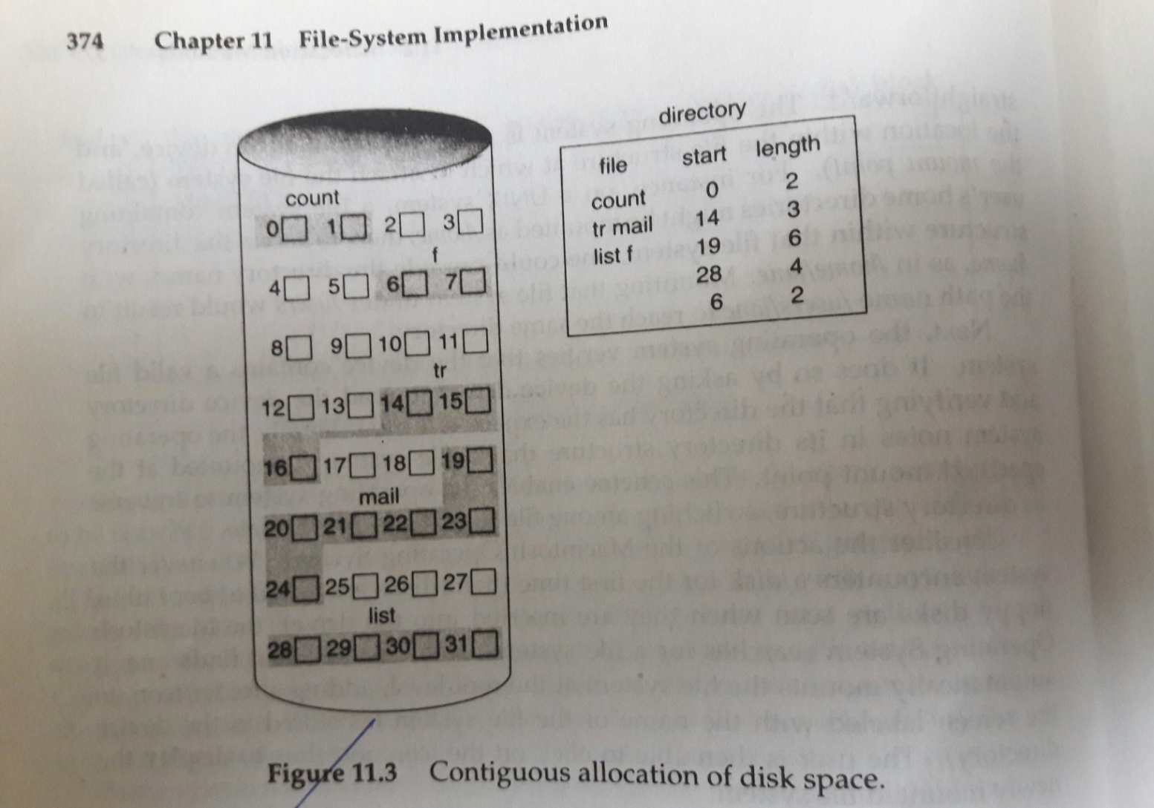
Contiguous allocation

Slide 18
Allocation methods
2. Linked allocation –
Each file is a linked list of disk blocks.
Problems – useful for sequential-access files, space for pointers, reliability.
Variation – file-allocation table (FAT)
random-access possible.

Slide 19
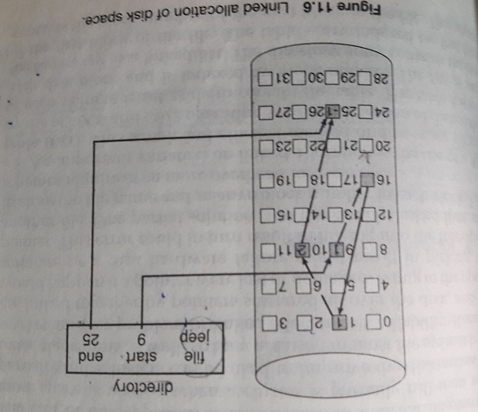
Linked allocation

Slide 20
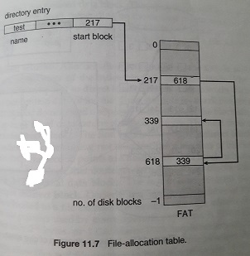
File-allocation Table
Variation on linked allocation.

Slide 21
Allocation methods
3. Indexed allocation -
All the pointers in one location – the index block (array of disk block addresses).
Direct access possible.
Space wastage.
Linked scheme, Multilevel index, combined scheme.

Slide 22
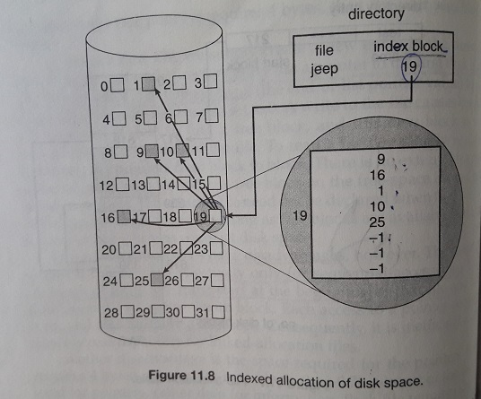
Indexed allocation

Slide 23
Free-space management
To keep track of free disk space, the system maintains a free-space list.
Records all disk blocks that are free.
Implementation of free-space list –
  bit map/bit vector : each block represented by 1 bit. If the block is free, the bit is 1, else 0.
  simple and efficient.
  to be kept in main memory.

Slide 24
Implementation of free-space list
Linked list –
  a pointer to the first free block is kept in a special location on the disk and is also cached in memory.
  to traverse the list, each block needs to be read which consumes substantial I/O time (inefficient).

Slide 25
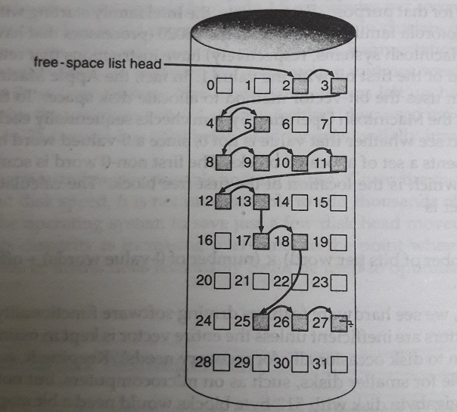
Linked free-space list on disk

Slide 26
Implementation of free-space list
Grouping –
  to store the addresses of n free blocks in the first free block.
  addresses of a large number of free blocks can be found quickly.
Counting –
  to keep the address of the first free block and the number n of free contiguous blocks that follow the first block.

Slide 27
Directory Structure
The file system is broken into partitions (or minidisks or volumes).
Each partition contains information about files within it.
This information is kept in entries in a device directory (or directory) or volume table of contents.
The directory records information for all files on that partition (name, location, size, type etc.).

Slide 28
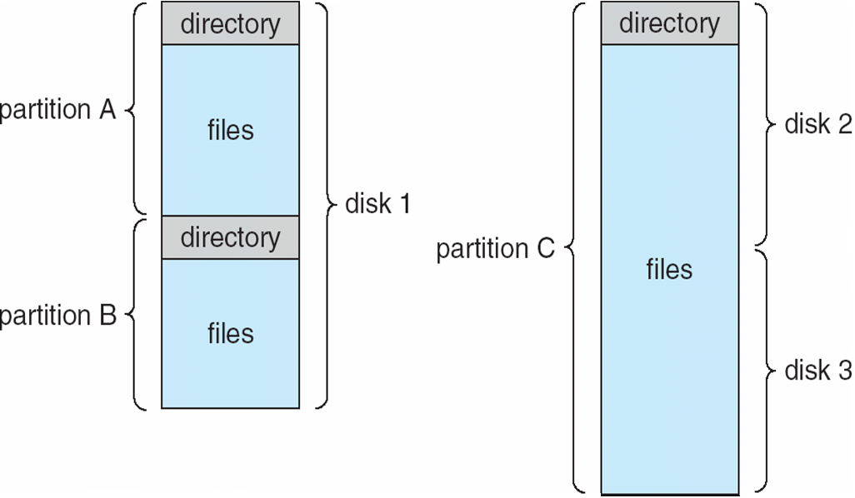
A typical file-system organization

Slide 29
Operations on a directory
Search for a file.
Create a file.
Delete a file.
List a directory.
Rename a file.
Traverse the file system.

Slide 30

SCHEMES FOR DEFINING THE LOGICAL STRUCTURE OF A DIRECTORY
Single-Level Directory -
All files contained in the same directory.
Limitations – When number of files increases or when the system has more than one user, then naming problem occurs. All files should have unique names.

Slide 31

Two-Level Directory (inverted tree of height 2)
Separate directory for each user known as user file directory (UFD).
Problem of user isolation.

Slide 32

Tree-Structured Directories
(most common)

Slide 33
Tree-Structured Directories
A directory is simply another file but it is treated in a special way.
One bit in each directory entry defines the entry as a file (0) or as a subdirectory (1).
Absolute path names or relative path names.
Prohibits the sharing of files or directories.

Slide 34

Acyclic-Graph Directories
Generalization of the tree-structured directory scheme.
Shared subdirectories and files.

Slide 35
Acyclic-Graph Directories
Compared to simple tree structure, more flexible but more complex.
Multiple absolute path names.
Do not want to traverse shared structures more than once.
Deletion.

Slide 36
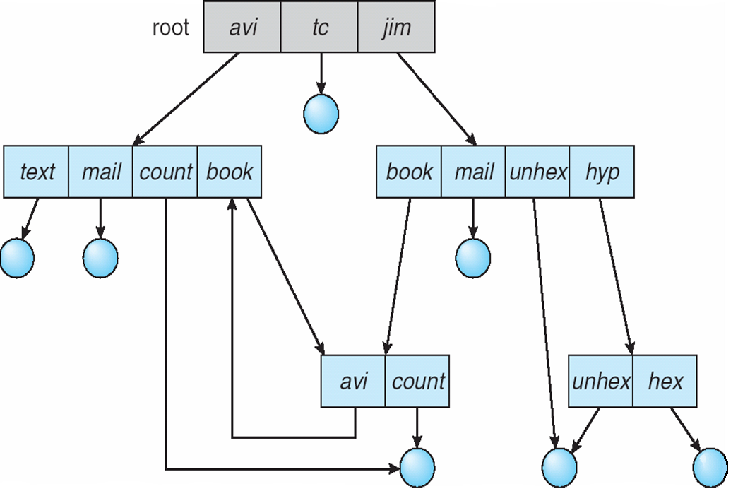
General Graph Directory

Slide 37
Directory Implementation
Linear List –
Linear list of file names with pointers to the data blocks.
Linear search - DISADVANTAGE.
Simple to program, time-consuming execution.

Slide 38
Directory Implementation
Hash Table –
Linear list stores the directory entries plus use of hash data structure.
A value computed from the file name serves as an index into the hash table.
Hash table returns a pointer to the file name in the linear list.
Reduction in directory-search time.

Slide 39
Directory Implementation
Hash Table –
Problems – fixed size of the hash table.
Dependence of the hash function on the size of the hash table.

